Slide 1
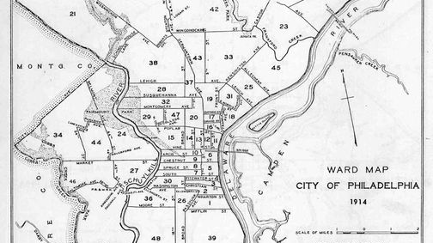
Waste in Philadelphia
Group project

Slide 2
Business Problem and Questions
Making a case to the City of Philadelphia to keep trying the Big Belly trash cans and leveraging the data the waste baskets are collecting.

Slide 3
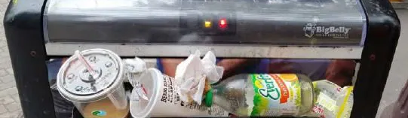
Validate the problem
A lot of Philadelphians hope to see improvements within the Streets Department. About 80 percent of people said the streets need to be cleaner.

Slide 4
Data Sources
Data | Dataset from: | Link:
Big Belly Trash Bin Usage | Philadelphia Streets Department | https://metadata.phila.gov/#home/datasetdetails/5543866e20583086178c4f1e/representationdetails/55438ab49b989a05172d0d55/
Big Belly Waste Baskets (Trash Bins) | Philadelphia Streets Department | https://metadata.phila.gov/#home/datasetdetails/555f8139f15fcb6c6ed4414f/representationdetails/556de53bcf0e0dca19464e91/

Slide 5
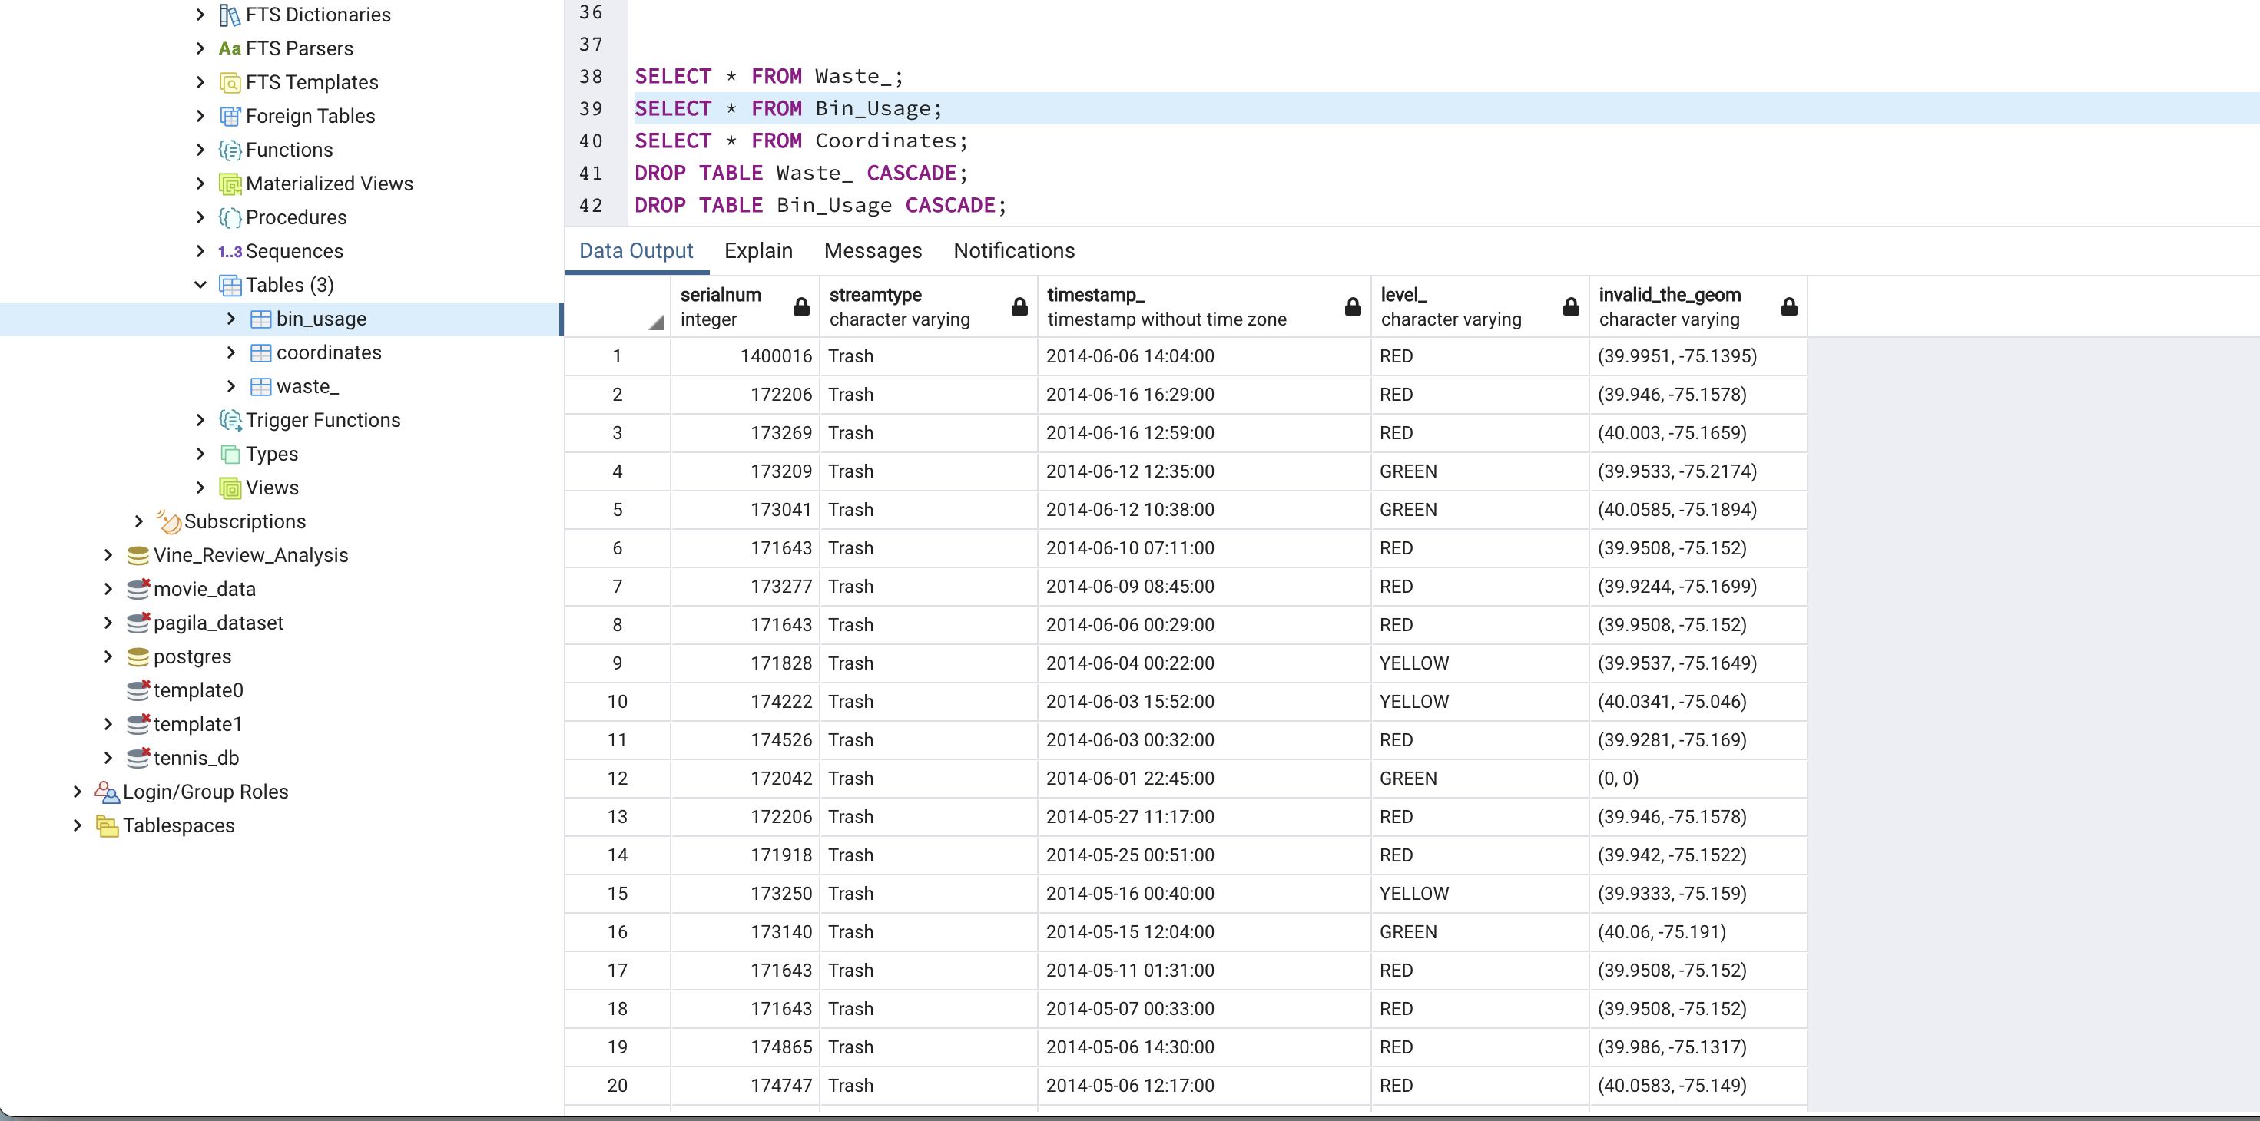
Database & Processing
Database used
SQL /pgAdmin
Processing of Data
We have 99,632 observations
We will access the data by using two CSV and creating tables for each file in pgAdmin. We then merged the files by creating a new table.
969 rows on waste_baskets 53869 rows on bin_usage
The only change we had to make in the CSV was to rename one of the columns
Continued →

Slide 6
Database & Processing

Slide 7
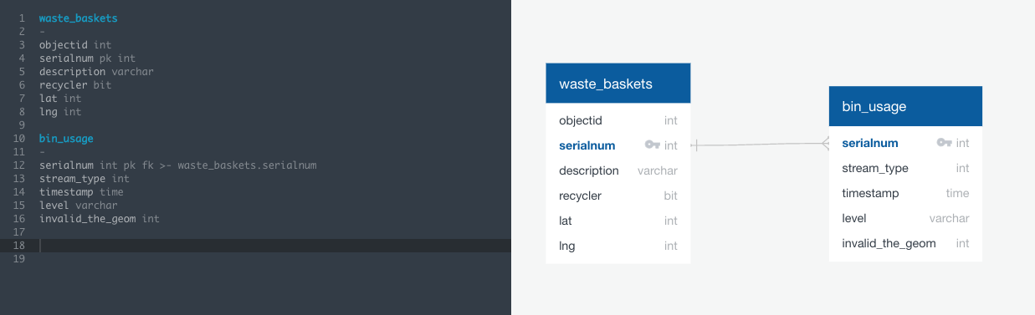

Slide 8
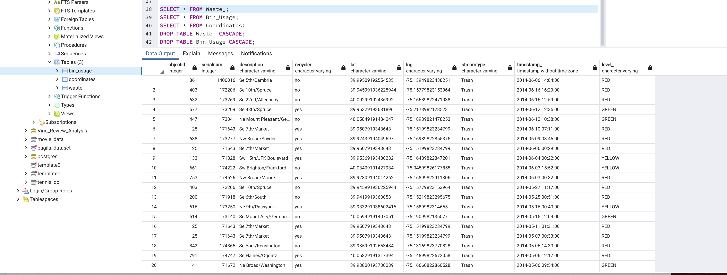

Slide 9
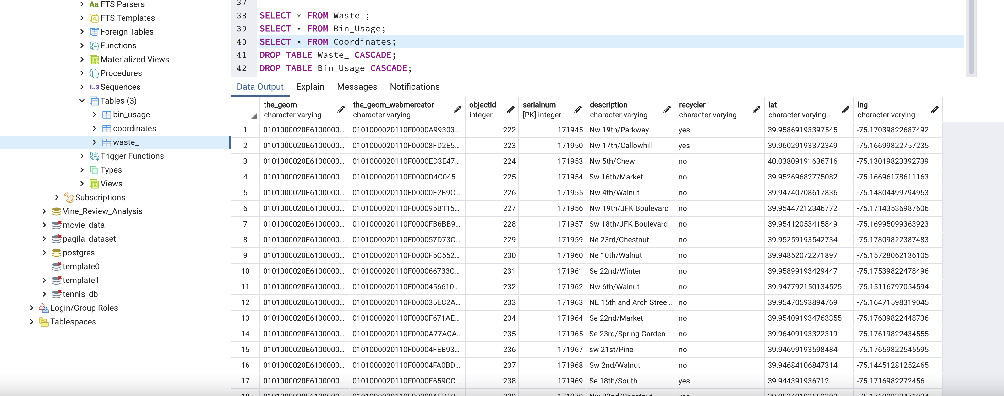

Slide 10
Python - Matplotlib
We are planning to write our code in Python using Matplotlib library that will provide heatmaps.

Slide 11
Machine LEARNING Model
We are still narrowing down the Machine Learning model that will be used for this analysis, below are some models that we are deciding from.
Classification
Will assist in making a recommendation. RBM – unsupervised learning, monitor a system, building a binary recommendation system, or working with a specific set of data
Monitor population to gauge frequency of trash pickup Arima – time series model, categorizes moving averages and auto-regression
Predict how much garbage is going to be generated, could be accurate for the next 4-5 years
Moving average – if it hits a certain point, this would be the impact of trash Linear Regression

